Slide 1
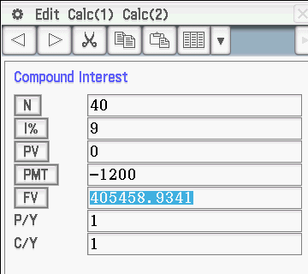
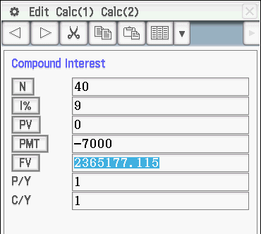
Superannuation and Annuities
Mr Mac is the retiring type – well very soon he will be – he wants to know how much he can afford to take out of his superannuation so he will have money for the next 35 years (yes then he will be rooooly old).
Firstly lets look at how he got the money in there to start with – something you will need/have to do and the earlier you start the more you will have – easier retirement.
His first wage was about $12000, at an interest rate of, lets say, 9% putting in 10% of his wage each year (this is employer and employee putting in). 10% of $12000 is $1200 invested yearly.
Say now you are starting out on $70000 per year investing $7000 each year for 40 years of working. You would have about $2 365 000 (before tax) to be invested.
Note: we haven’t factored in CPI increases to wages in either of these and the 15% tax the Government takes at the roll over date. Don’t forget that your money at the moment isn’t as much as you will be getting when you retire. Also the 15% tax is less than what you would pay you took it all from your earnings at 30% or 40% tax.
So Mr Mac would have about $405000 (before tax) to invest for his retirement.

Slide 2
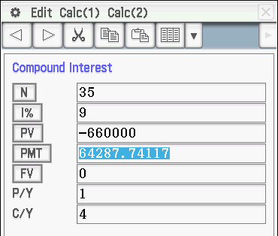
Now Mr Mac has been very good over his working life and has $759 000 invested in superannuation. The government takes 15% for tax so this leaves $660 000 to invest for the next 35 years taking an annuity out each year and getting 9% interest added each year. Note: if he takes less than 9% out each year it would be an increasing investment and visa-versa.
This gives me about $64 000 per year to live on for the rest of my life, if I survive through to 98 years old. Note: this doesn’t take into account CPI increases, so I should only take out, say $59 000 in the first year and increase it slightly each year so I keep up with CPI, this is called Indexing.
Lets look at this on the next page

Slide 3
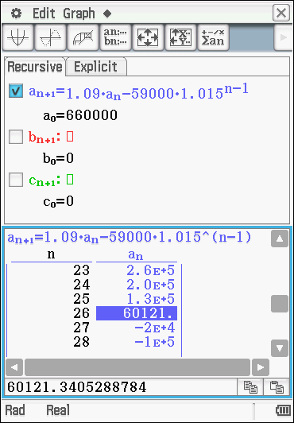
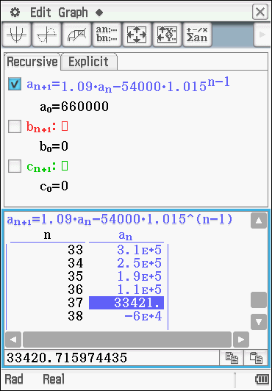
Indexing
Lets look at my $750 000 invested at 9% per annum with me withdrawing $65 000 yearly and wanting this increased at 1.5% each year (to keep up with CPI), will it last through for 35 years. This one can’t be done with the Finance App and must be done with Sequences.
On the left you can see that taking an annuity of $59 000 that would only last me for 26 years, using the CPI index of 1.5%.
Changing some numbers ie taking a starting annuity of $56 000 would make it last for 31 years but using a starting amount of $54 000 I would be able to go through for 37 years. See right.

Slide 4
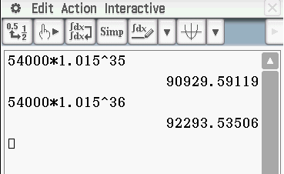
How much would I be getting in 35 or 36 years time
This is just as an aside bit of information so you can see what happens over time.
As you can see on the left my yearly annuity would have increased from $54 000 per year at the start to
$90 929.60 in 35 years time
And
$92 293.50 in 36 years time
This is by adding the 1.5% CPI index each year.

Slide 5
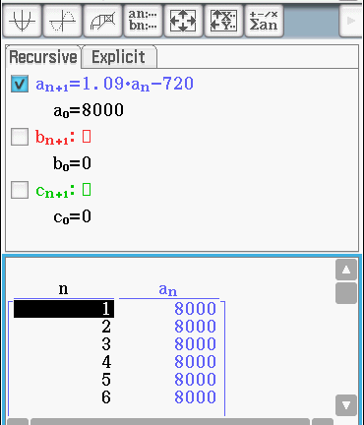
Perpetuities
Another way money can be used to provide for others into the future is using perpetuities (meaning lasting forever). This is where a sum of money is put into an investment organisation and the interest earned each year is given away or used in some way. The original amount isn’t touched and stays there for the following year to gain interest again.
An example of this might be – I set up a perpetuity for a student at BSC who is going to go on studying but has some problems being able to afford it. I have set aside $8000, still with my 9% pa. How much will be gifted each year.
9% of $8000 is $720, so $720 can be gifted each year. Lets look at this on the Sequence App below.
As you can see there is $8000 left each year.
Try exercise 4A pages 91 - 94

Slide 6
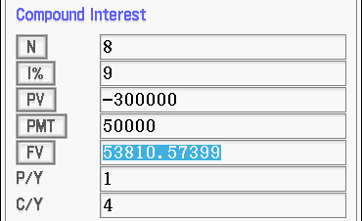



What happens if the frequency of compounding doesn’t equal the frequency of payments – yes we will be using that C/Y and P/Y part of the Compound Interest App
What happens if I have invested some money, say $300 000, getting our 9% per annum compounded quarterly and I want to have $50 000 withdrawn each year (yearly). (a) How much will I have left at the end of 6 years and then (b) How long will it last till the final payment is less than $50 000?
(b)
(a)
Using the Finance App it is a bit of a guessing game. I tried N = 8yrs first then 9 & 10.
Please note: this occurs in year 10 with a final payment of :
50000 – 40359.62 = $9640.38
This is the payment at the end of year 10 with the interest added – not the FV at the end of year 9.
This shows up easier using the Sequence App – next page.
Note: this is 4 as it is compounding 4 times a year.

Slide 7
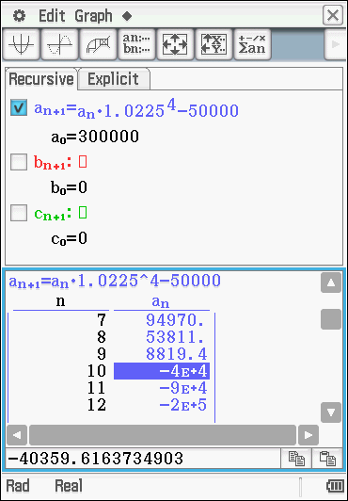
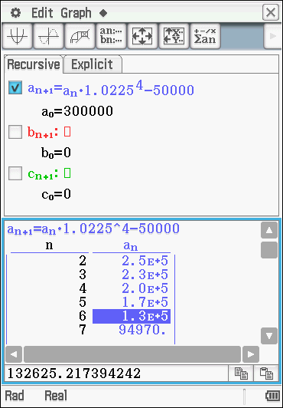
Using the Sequence App
Note: this is 4 as it is compounded 4 times a year and the interest is 1.0225 as the 0.0225 is 9÷4
(b)
Using the Sequence App can be easier as you look down the list till the first negative one occurs.
Same as before this occurs in year 10 with a final payment of :
50000 – 40359.62 = $9640.38
This is the payment at the end of year 10 with the interest added – not the amount at the end of year 9.
(a)
We look at 6 on the list to find the answer for 6 years. If we click on it the answer to many dp’s is shown here
Now do Exercises 4B and finish the Miscellaneous exercises 3 & 4.

Slide 8
FINANCIAL CALCULATIONS – using the Financial App
Interest
The price paid for borrowing money. It is expressed as a percentage rate over a period of time.
Principal
The total amount of money being borrowed or lent.
Simple interest
Interest calculated as a simple percentage of the original principal amount.
Compound interest
Interest paid on previously earned interest as well as on the principal.
Future Value - FV
The value of an asset or cash at a specified date in the future that is equivalent in value to a specified sum today. There are two ways to calculate FV:
Present Value - PV
The amount of cash today that is equivalent in value to a payment, or to a stream of payments, to be received in the future.
Payment = PMT
The payment is how much is paid in or how much you receive as payment back
P/Y 1 if yearly or 12 if the payments are monthly
C/Y 1 if yearly or 12 if the interest is added monthly.

